Slide 1


Banking Iya Bola
Empowering Africa through Data-Driven Inclusion

Slide 2
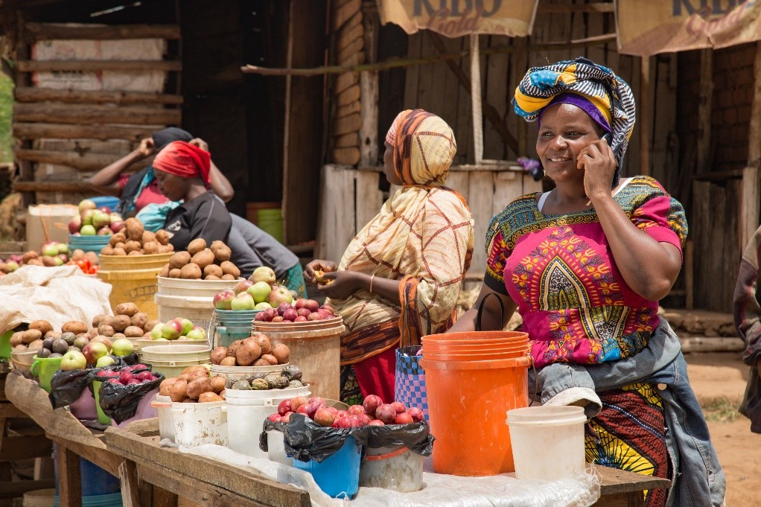
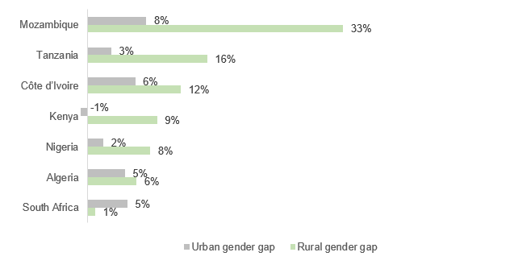
Validated Understanding of the Problem
In Sub-Saharan Africa, only 49% of adults have a bank account.
Millions remain excluded due to language barriers, digital illiteracy, and infrastructure gaps.
Significant disparities exist (6% in South Sudan to 91% in Mauritius).
Source: GSMA

Slide 3
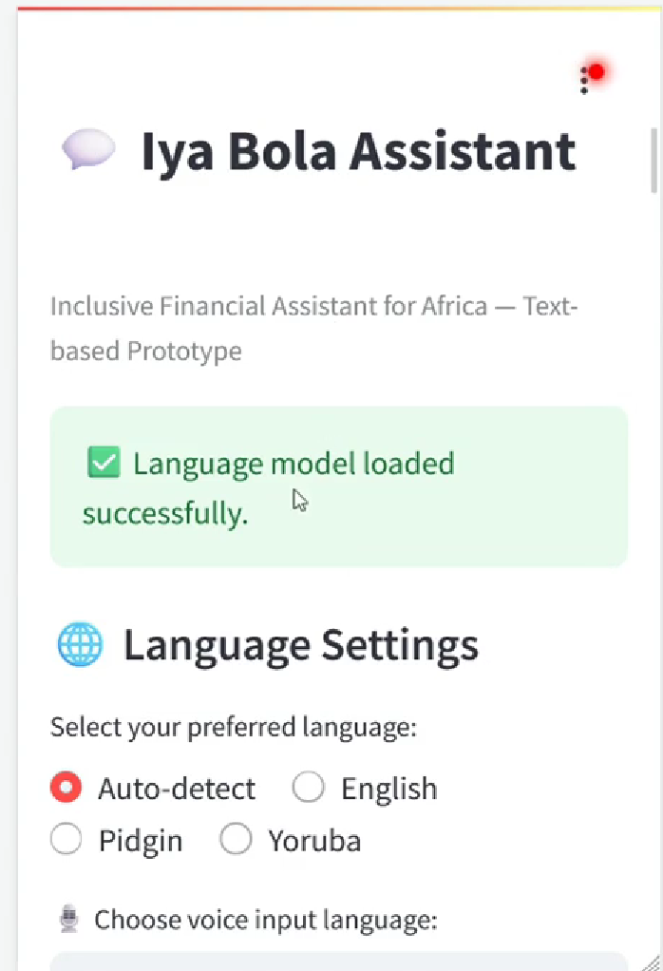
Meet Iya Bola Assistant
An inclusive multilingual assistant that speaks English, Pidgin, and Yoruba. Designed for accessibility, trust, and ease of use.
Inclusive financial assistant supporting text and optional voice input.
Handles essential financial tasks and extended services (financial education, agriculture payments, school fee reminders).
Designed for low-digital-literacy users with trust, usability, and accessibility in mind.

Slide 4
What Iya Bola Can Do
Core Financial Functions:
💸 Transfers
📱 Airtime/Data
💡 Bill Payments
💰 Micro-Savings
📖 Financial Education Tips
Beyond Banking:
📖 Financial Literacy Tips
🌾 Agricultural Payment Integration
🏫 School Fee Reminders

Slide 5
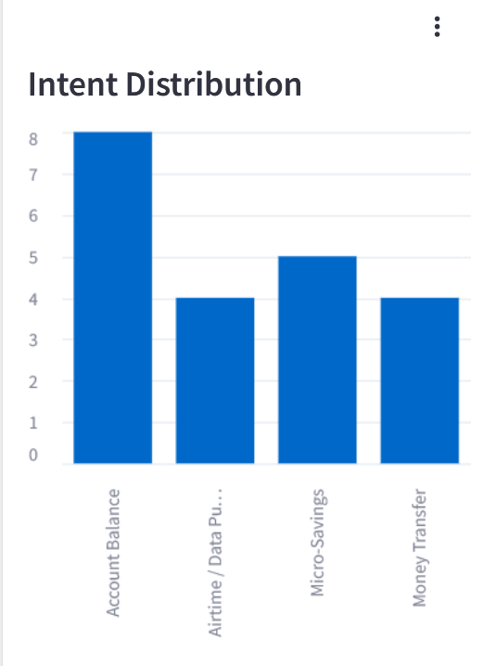
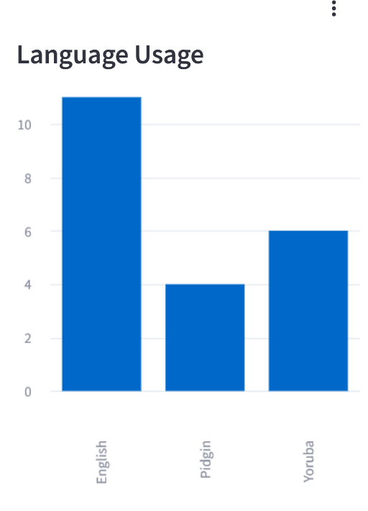
Real-Time Analytics Dashboard
Track intents, languages, and user engagement. See what services are driving inclusion.

Slide 6
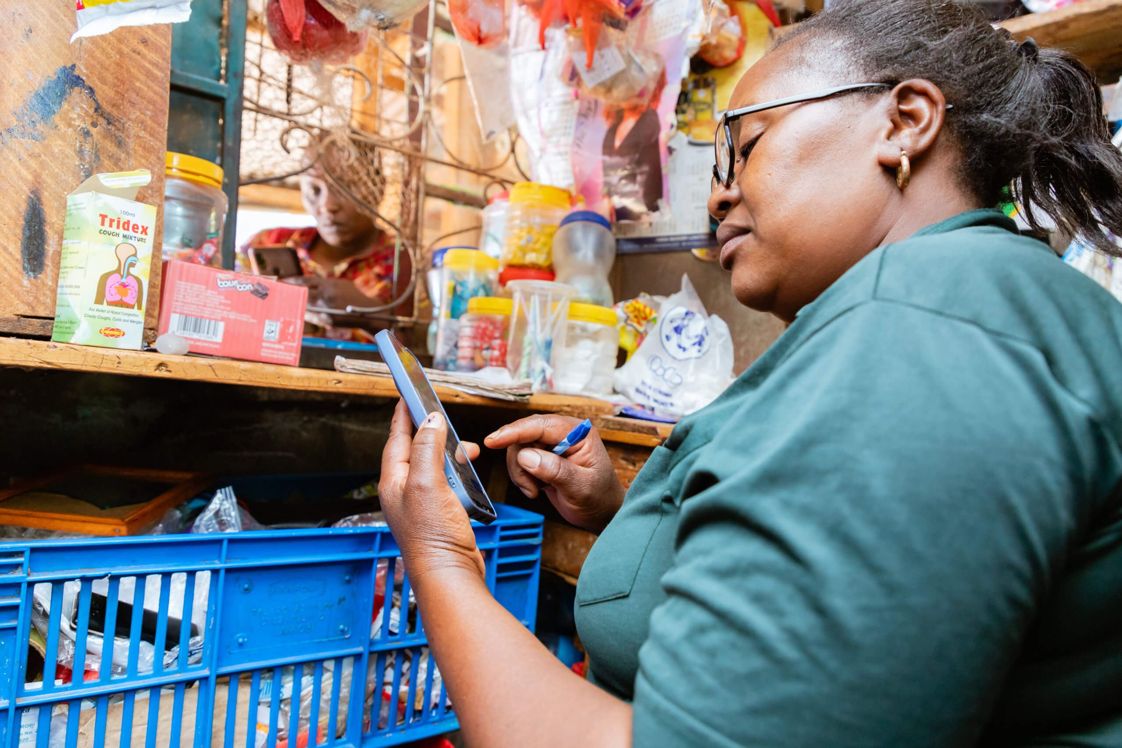
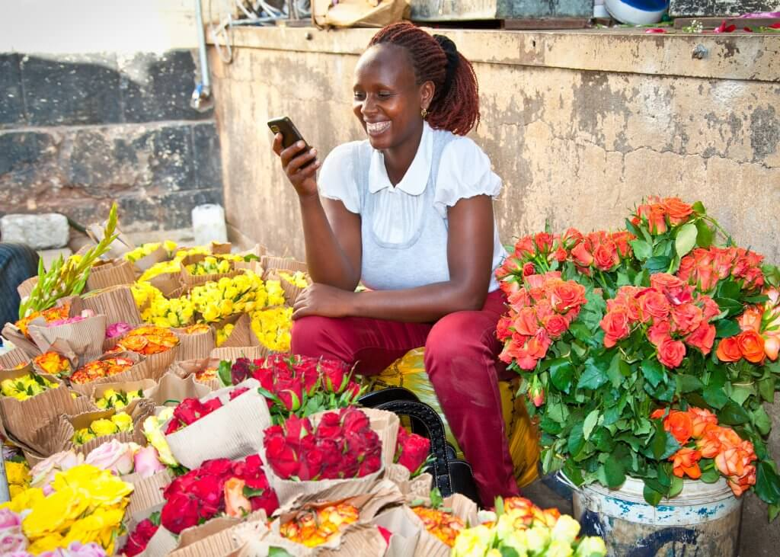
Impact & Scalability
Driving inclusion one conversation at a time.
Designed for banks, fintechs, telcos, and community organizations.
Supports adoption in underserved regions to increase financial inclusion.
Modular design allows addition of new languages, services, and regions.
Ensures privacy, trust, and usability for users with low digital literacy.

Slide 7
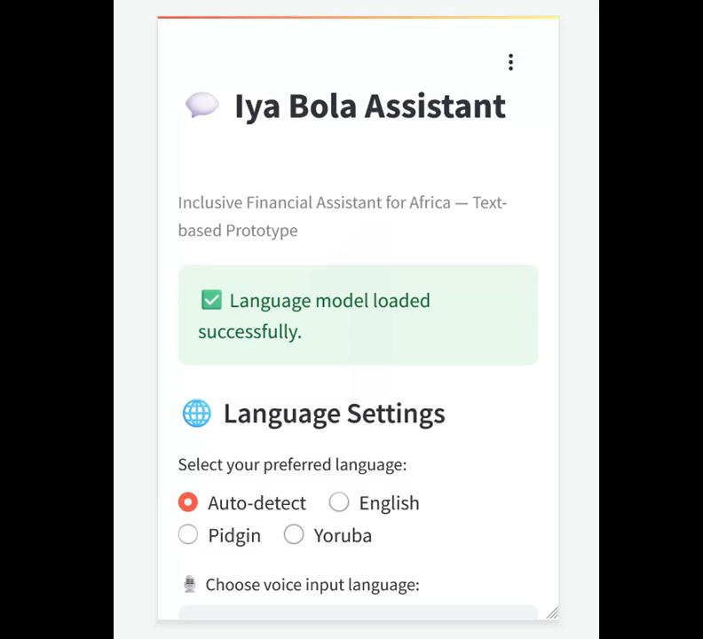
Live Demo
Experience the prototype live!
👉 https://datathon-2025-full-1.onrender.com

Slide 8
Iya Bola Assistant App
Powered by Team GrandMEAN
for Dataverse Datathon 2025

